Slide 1
BIOE 498 / BIOE 599: Computational Systems Biology for Medical Applications CSE 599V: Advancing Biomedical Models Lecture 1: Introduction and Biochemistry Basics
Joseph L. Hellerstein*
Herbert Sauro**
*eScience Institute, Computer Science & Engineering
**BioEngineering

Slide 2
Agenda
Course Introduction & Overview
Biochemistry essentials

Slide 3
Why Biomedical Engineering?
Precision Medicine
Novel Materials

Slide 4
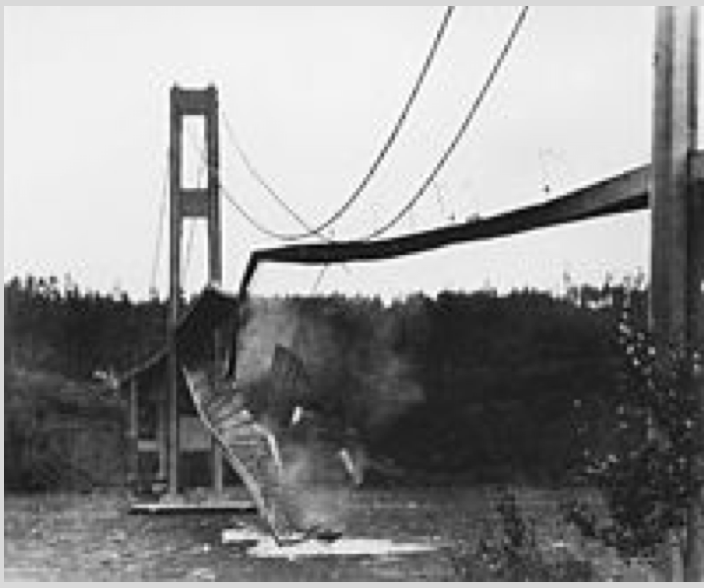
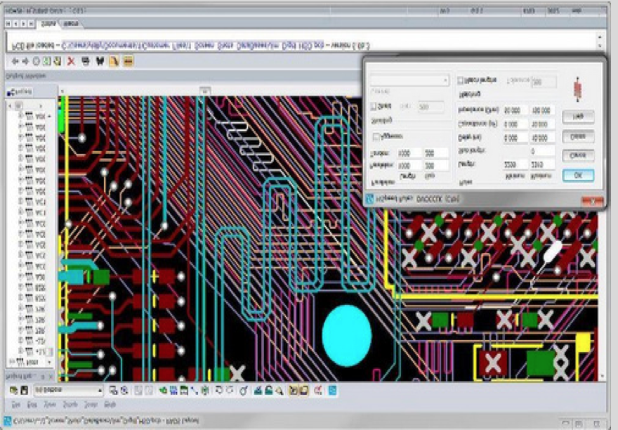
Why Models?
Disasters should occur in silico,
not in vivo.
Emulate experience with hardware design.

Slide 5
Course Goals
BIOE & CSE: Develop skills with building quantitative models of biological systems.
CSE: Develop a research agenda for developing tools for modeling biological systems.

Slide 6
Instructors
Herb Sauro, Professor BIOE
Joseph Hellerstein, Senior Fellow eScience Institute, Affiliate Professor CSE
PhD in Computer Science
Industry (30+ years): IBM Research, Microsoft, Google
IEEE Fellow, mathematical models for scheduling distributed computing systems

Slide 7
BIOE 599/498 Objectives & Grading

Slide 8
CSE 599V Objectives & Grading
Learning objectives
Explain the need for biomedical models
Construct kinetics models of simple biological systems
Describe a software tool that addresses at least one common problem in building biomedical models.
Grading
Homework: 20%
Paper review: 30%
Course project: 50%

Slide 9
CSE 599V Web Site

Slide 10
Syllabus By Week
CSE 599V
Joint
Basics of Biochemistry & Modeling
Fitting Parameters & Debugging Models
Model Engineering Overview & Survey
Systems Biology Modeling
Uncertainty in Models & Parameters
Model Engineering Tools
Build a Model
Modeling Workflows & Standards
Student Research Proposals
Student Reviews of Modeling Papers

Slide 11
Technical Statement of Course Objectives
BIOE & CSE: Develop skills with building kinetic models that explain biological processes through the creation and destruction of biomolecules and biomolecular complexes.
The remainder of the class will explain each of the underlined terms.
Notes:
This lecture is about what we will model. Next lecture is the how of modeling.

Slide 12
Biology Basics
A brief history of life, its organization, and processes.
Biochemistry essentials (biomolecules, biomolecular complexes, enzymes)
Kinetic models

Slide 13
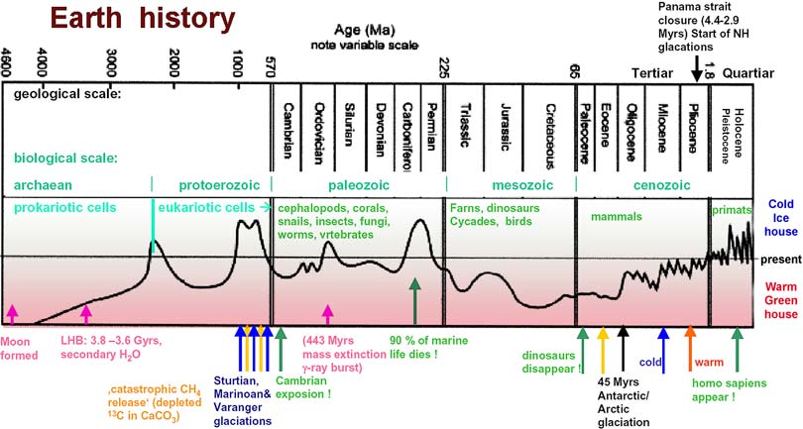
sciencemax.pbworks.com
Notes:
Simple life happened very early, within 0.5B years.
Complex cells took another 2.5B years
After Eukaryotic cells developed, quickly get multi-cellular organisms.

Slide 14
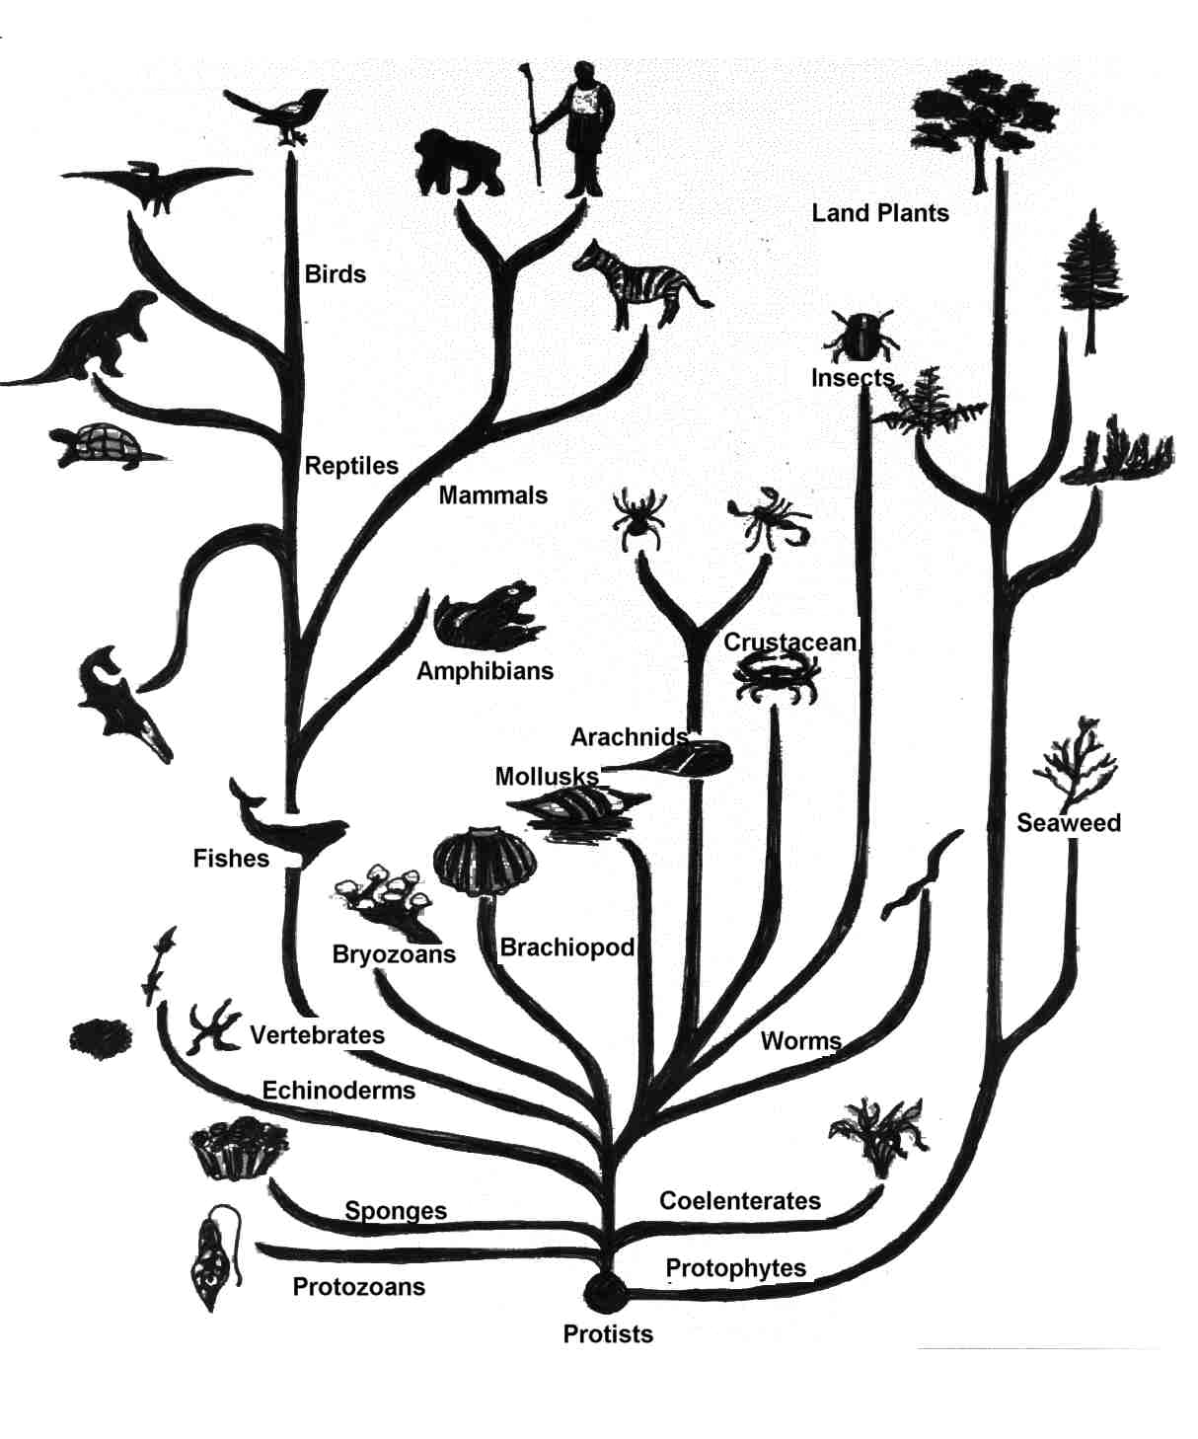
Tree
Of
Life
library.thinkquest.org

Slide 15
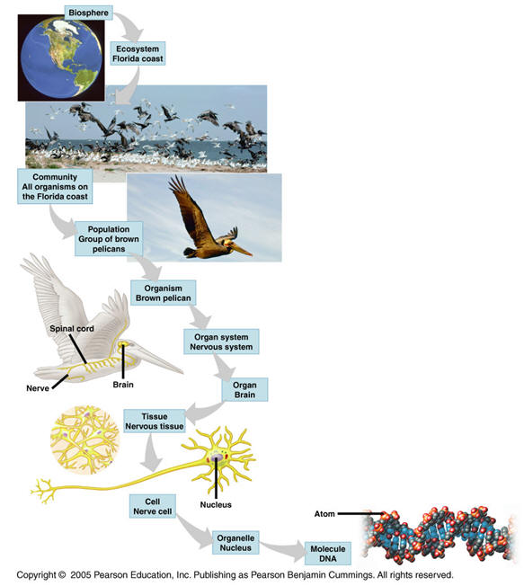
Levels of organization of life
DNA controls much of the chemistry of life.
Cells are a unit common to all life.

Slide 16
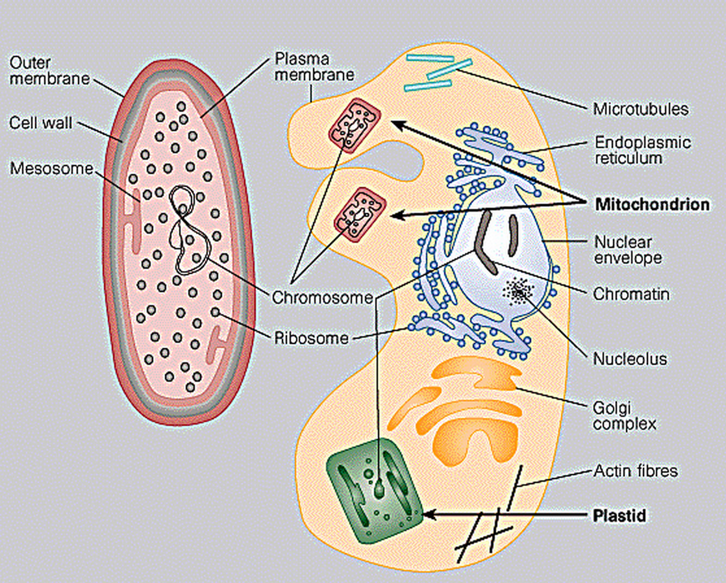
Prokaryotes (3.5B)
0.2-20 microns
0.2-20 microns
10-100 microns
10-100 microns
Prokaryote
Eukaryote
Eukaryote

Slide 17
Prokaryotes (3.5B) vs. Eukaryotes (1.5B)
0.2-20 microns
0.2-20 microns
10-100 microns
10-100 microns
Prokaryote
Prokaryote
Eukaryote
Eukaryote

Slide 18
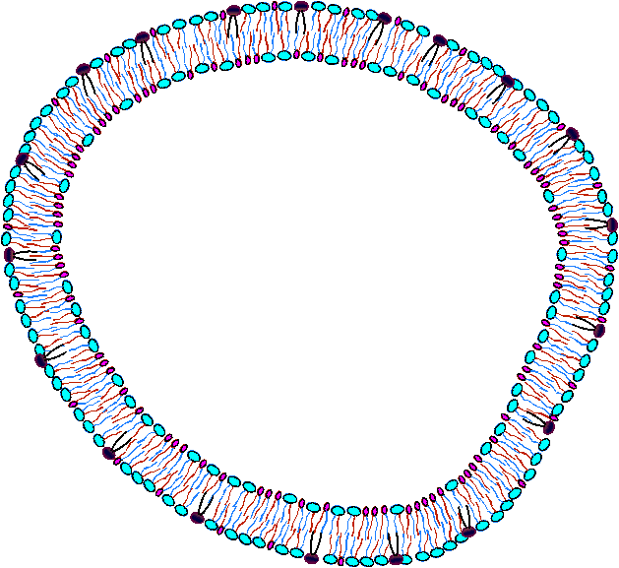
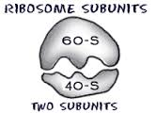
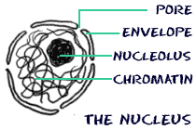
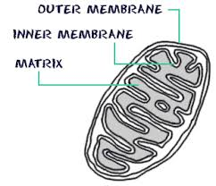
Simplified Cell Structure
Plasma membrane – controls entry and exit of molecules
Cytosol – interior of cell minus the organelles & locus of many pathways
Ribosome – constructs proteins from mRNA created in nucleus
Nucleus – exports mRNA and other molecules
Mictochondrion – Locus of key energy pathways

Slide 19
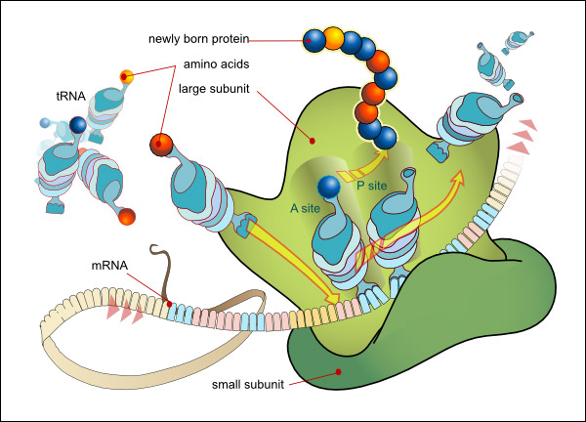
Pop Quiz: What’s This?

Slide 20
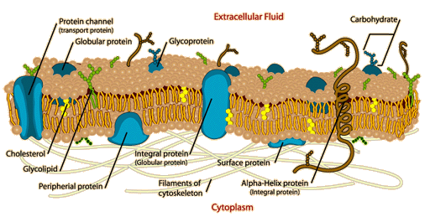
Substructures
Mitochondrion
(Biology4Kids.com)
(Biology4Kids.com)
Cell Membrane
(http://hyperphysics.phy-astr.gsu.edu/hbase/biology/celmem.html)

Slide 21
Functions of a Cell
Build and degrade structures
Replicate (mitosis)
Metabolize
Take in food; transform it into cell energy
Expel molecules (e.g., waste)
Locomotion
Done by a sequence of chemical reactions (pathways) on biomolecules.

Slide 22
Key Biomolecules
Hydrocarbons (Aliphatic molecules)
Carbohydrate
Lipid
Protein
Nucleic Acid Polymers (RNA, DNA)

Slide 23
Hydrocarbons
Only Carbon & Hydrogen
Starting point for building biomolecules
Uses
High energy

Slide 24
Lipids
Polar head group plus chains of hydrocarbons
Uses
Energy storage
Membranes

Slide 25
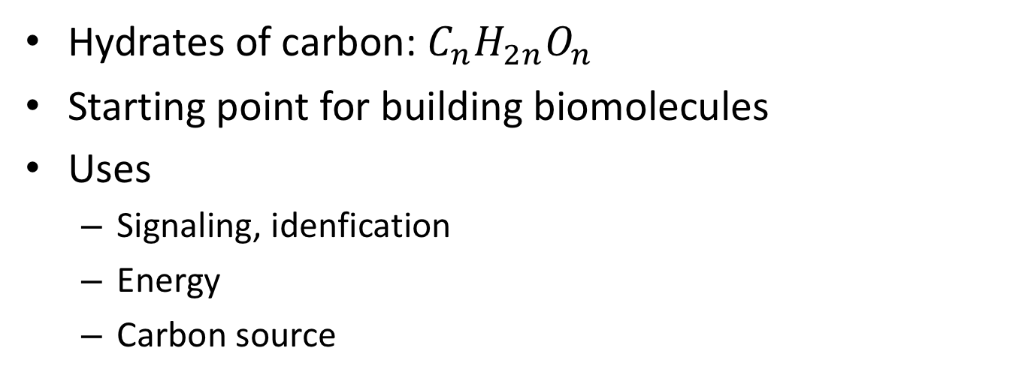
Carbohydrates
Hydrates of carbon: $C_{n}H_{2n}O_{n}$
Starting point for building biomolecules
Uses
Signaling, idenfication
Energy
Carbon source

Slide 26
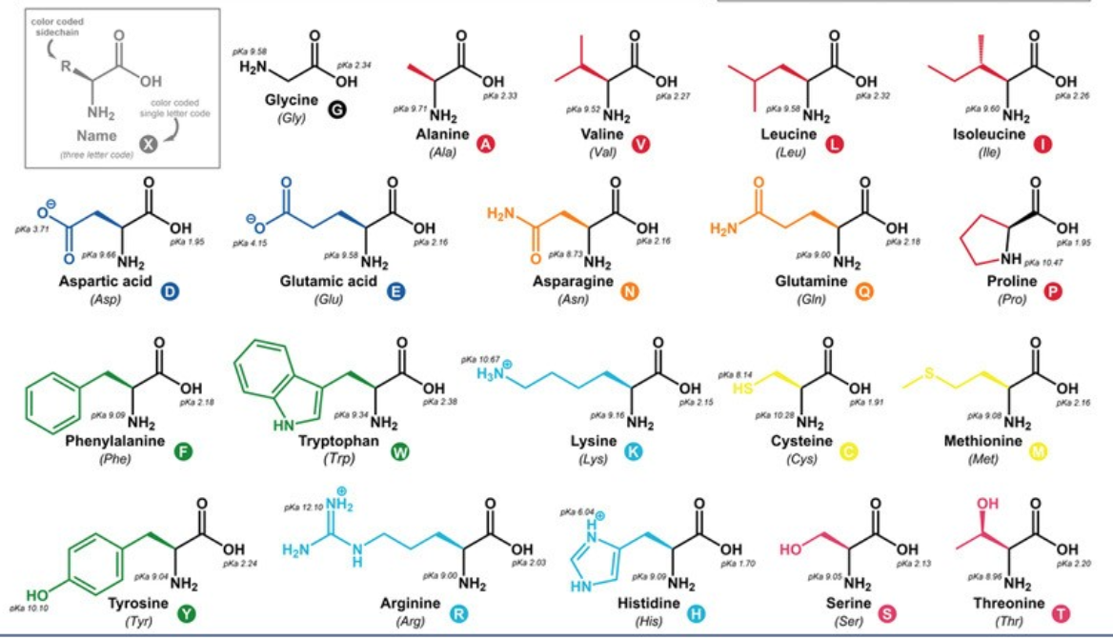
Protein
Amino Acids
Protein building blocks
Determines protein structure
Determines protein activity
Protein
3-d organization
Central to signaling, transport, catalyzing metabolism

Slide 27
Nucleotides
No 2’ O => deoxy
Has 3 parts: nitrogenous base, ribose (sugar), Phosphate
Notes:
Adenine

Slide 28
Ribonucleic Acid
Phosphate group connects the nucleotides
Directional: 5’ & 3’ ends
Nitrogenous bases are A, C, G, U

Slide 29
Deoxyribonucleic Acid
Directional: 5’ & 3’ ends
Nitrogenous bases are G, C, A, T (not U)
Double stranded.
Hydrogen bonding between nitrogenous bases
Anti-parallel

Slide 30
Cellular Structures Are Assemblies of Biomolecules: Ribosome

Slide 31
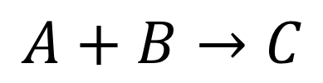
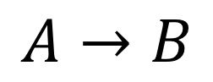
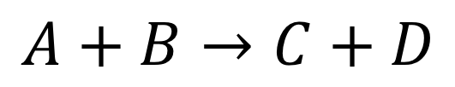
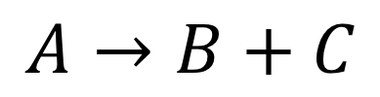
Chemical Reactions Assemble and Disamble Molecules
Reactants
Products
Reaction Types
$$A→B$$
Mono-Mono
$$A+B→C$$
Bi-Mono
$$A→B+C$$
Mono-Bi
$$A+B→C+D$$
Bi-Bi

Slide 32
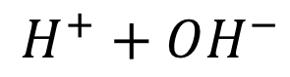
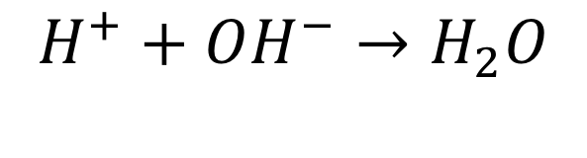
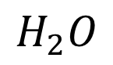
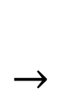
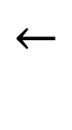
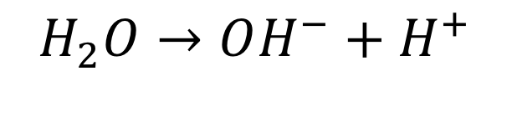
Examples
Type of reaction?
Reactants?
Products?
$$H^{+}+OH^{−}→H_{2}O$$
$$H_{2}O→OH^{−}+H^{+}$$
Type of reaction?
Reactants?
Products?
$$←$$
$$H^{+}+OH^{−}$$
$$←$$
$$H_{2}O$$
Reversible reaction
Notes:
These are likely the most important reactions in biology.

Slide 33
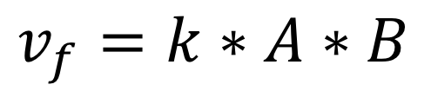
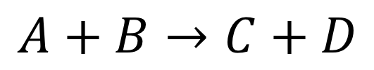
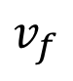
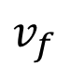
Reaction Kinetics
How fast do reactions go:
Mass action kinetics
Constant times the concentrations of the reactants
$$v_{f}$$
$$v_{f}$$
$$A+B→C+D$$
$$v_{f}=k∗A∗B$$

Slide 34
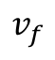
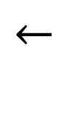
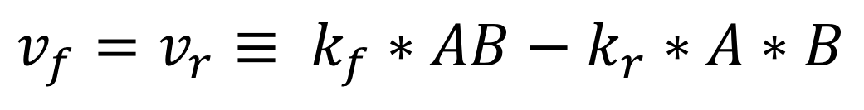
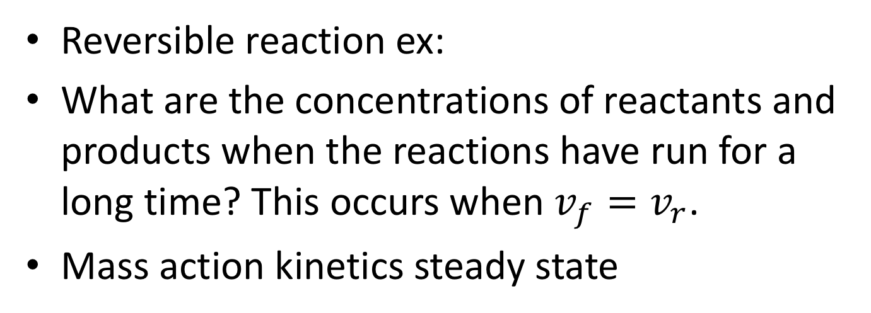
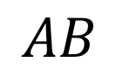
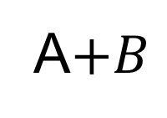
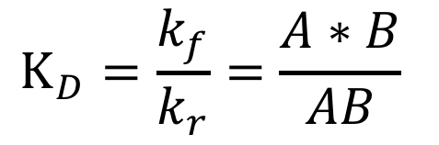
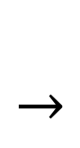
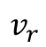
Reversible Reactions & Steady State
$$←$$
$$v_{f}$$
Reversible reaction ex:
What are the concentrations of reactants and products when the reactions have run for a long time? This occurs when $v_{f}=v_{r}$.
Mass action kinetics steady state
$$AB$$
$$←$$
A$+B$
$$v_{r}$$
$$v_{f}=v_{r}≡ k_{f}∗AB−k_{r}∗A∗B$$
Disassociation Constant
$$K_{D}=\frac{k_{f}}{k_{r}}=\frac{A∗B}{AB}$$

Slide 35
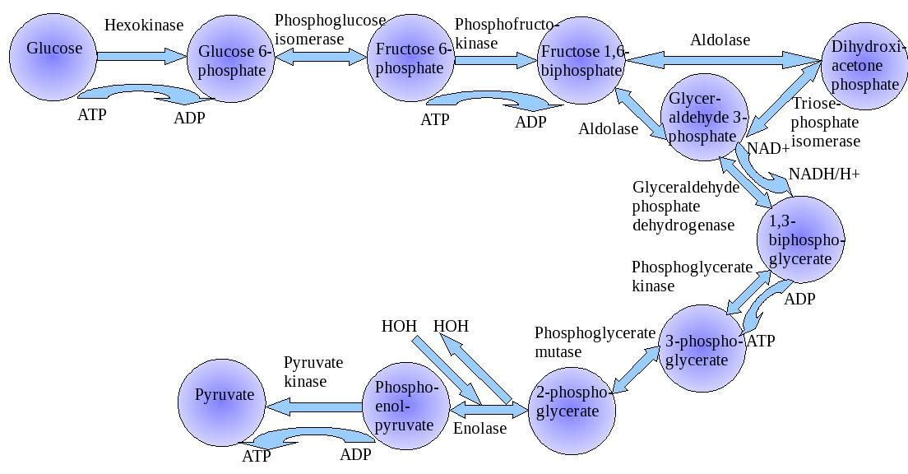
Glycolysis

Slide 36
Enzymes
Proteins that accelerate biochemical reactions.
Omni present in biology
Induced Fit Operation of Enzymes

Slide 37
Enzyme Inhibition

Slide 38
Biochemical Reactions
Reactant
Molecules
Product
Molecules
Enzyme
But Arcs are often bidirectional
(since chemical reactions can be reversed)
And enzymes may be modified in pathway regulation
(self-modifying code!)
Another Enzyme

Slide 39
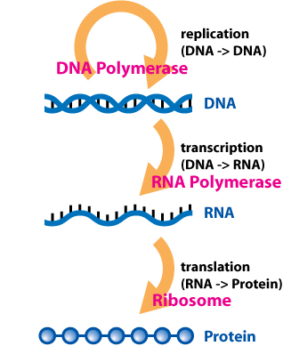
Central Dogma of Biology How Proteins/Enzymes are Made
Retroviruses

Slide 40
Enzyme Basics

Slide 41
Genes, Proteins, Metabolites

